Slide 1

ENGINEERING CHEMISTRY
Asha A
Department of Science and Humanities

Slide 2

ENGINEERING CHEMISTRY
Module I- Molecular Spectroscopy
Module content:
Interaction of electromagnetic radiation with matter
Electromagnetic spectrum
Born –Oppenheimer approximation
Beer-Lambert’s law
Microwave spectroscopy- diatomic rigid rotor model and the rotational spectrum
IR spectroscopy- diatomic harmonic oscillator and anharmonic oscillator model
Electronic spectroscopy- Vibrational coarse structure(Progressions), Franck Condon Principle

Slide 3
ENGINEERING CHEMISTRY
Module I- Molecular Spectroscopy
Class content :
Definition of Molecular spectroscopy
Interaction of electromagnetic radiation with matter
Comparison between atomic and molecular spectra
Quantisation of energy
Absorption and emission spectra
Spectroscopic units

Slide 4
ENGINEERING CHEMISTRY
Module I- Molecular Spectroscopy
Molecular spectroscopy is that branch of science which deals with the study of interaction of electromagnetic radiation with matter(molecules)
Incident radiation → sample → detector→ diffraction grating → recorder(spectrum)

Slide 5
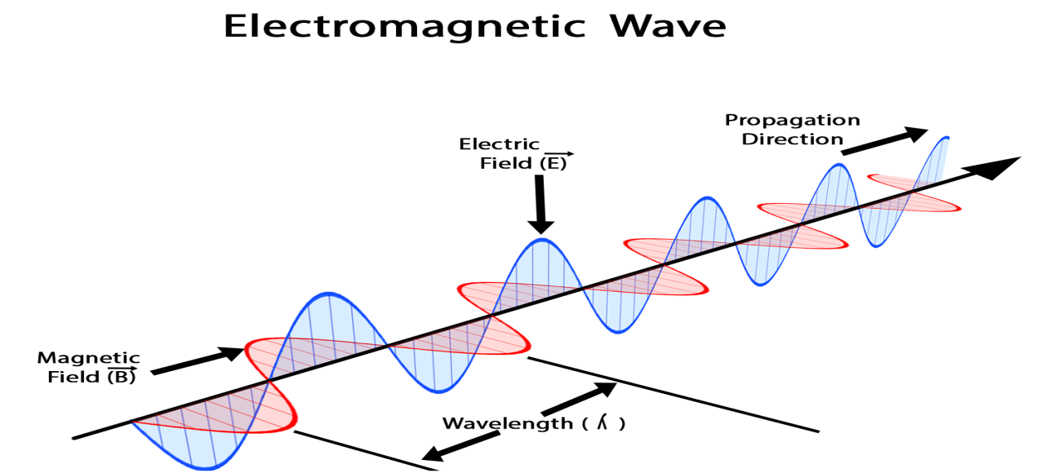
ENGINEERING CHEMISTRY
Module I- Molecular Spectroscopy
Some important features of electromagnetic radiations are:
They have dual character i.e. particle character as well as wave character, for example, a beam of light is a stream of particles called photons moving through the space in the form of waves
These waves are associated with electric and magnetic fields oscillating perpendicular to each other and also perpendicular to the direction of propagation
All electromagnetic radiations travel with the velocity of light
Source:https://byjus.com/physics/characteristics-of-em-waves/

Slide 6
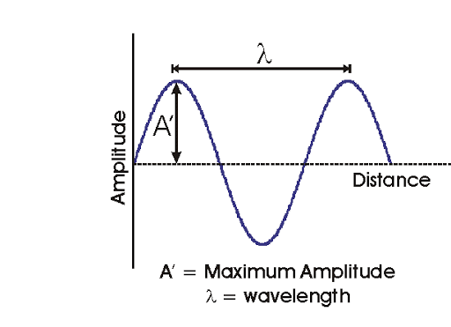
ENGINEERING CHEMISTRY
Module I- Molecular Spectroscopy
Waves can be characterised by the following properties :
Wavelength : The distance between two successive crests and troughs of the wave ; λ ; m , nm or Aº
Frequency : The number of cycles completed in a certain amount of time ; ν ;Hz or s⁻¹
Wave number : Number of complete waves or cycles
contained in unit distance ; , cm⁻¹
Energy of electromagnetic radiation is given by E=hν , where
E is energy,h is Planck's constant,(h= 6.625 x 10⁻³⁴ Js), and ν is frequency
Wavelength is related to frequency by c=λν , where
c is the speed of light, λ is wavelength, and ν is frequency
Wave number is related to wavelength by
http://www.chemistry.wustl.edu/~coursedev/Online%20tutorials/Waves.htm

Slide 7
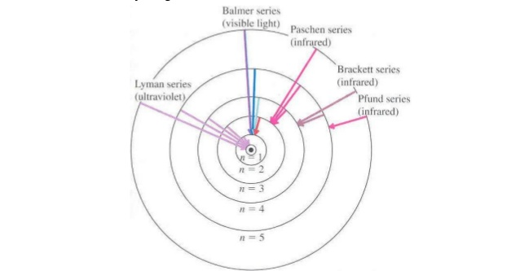
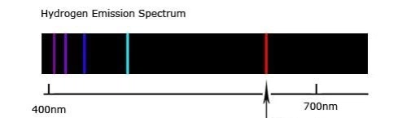
ENGINEERING CHEMISTRY
Module I- Molecular Spectroscopy
Comparision between atomic spectra and molecular spectra
Atomic spectra
Due to electronic transitions from one atomic orbital to
another
Gives rise to line spectra
Source:https://socratic.org/questions/what-happens-to-the-distance-between-energy-levels-at-higher-energy-levels
Source:https://www.slideshare.net/mizakamaruzzaman/phy-310-chapter-5

Slide 8
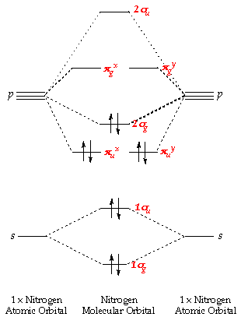
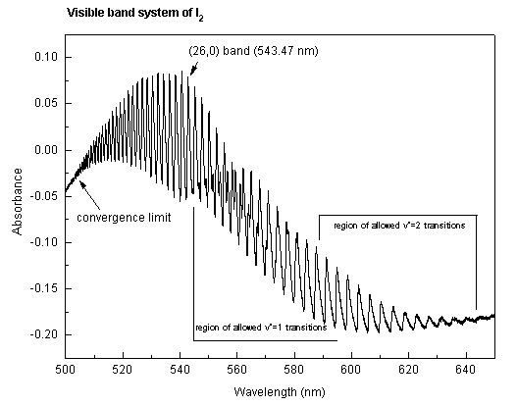
ENGINEERING CHEMISTRY
Module I- Molecular Spectroscopy
Molecular spectra
Due to electronic transitions from the Highest occupied molecular orbital(HOMO) to Lowest unoccupied molecular orbital(LUMO)
Gives rise to band spectra due to rotational and vibrational transitions possible in molecules along with electronic transitions
Source:https://chem.libretexts.org/Courses/Pacific_Union_College/Quantum_Chemistry/13%3A_Molecular_Spectroscopy/13.06%3A_Electronic_Spectra_Contain_Electronic%2C_Vibrational%2C_and_Rotational_Information
Source:https://socratic.org/questions/what-are-the-molecular-orbital-configurations-for-n-2-n-2-2-n-2-n-2-and-n-2-2

Slide 9
ENGINEERING CHEMISTRY
Module I- Molecular Spectroscopy
Quantisation of energy
Energy levels in atoms or molecules are discrete or quantised
Energy can be absorbed only in packets called quanta
Frequency of light absorbed when there is a transition between two energy levels depends on the difference in energy between the two energy levels
If an atom or molecule in ground state absorbs energy there exists a higher energy level corresponding to the frequency of light absorbed
E₂
E₁

Slide 10
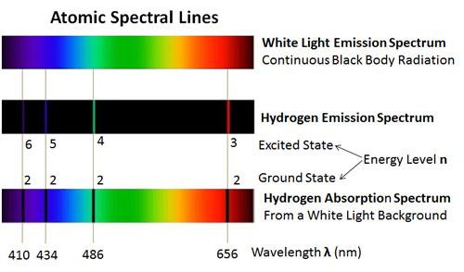
ENGINEERING CHEMISTRY
Module I- Molecular Spectroscopy
Absorption and Emission spectrum
Absorption spectrum is observed when an atom or molecule absorbs energy and moves from lower energy level to higher energy level
Emission spectrum arises when molecule comes from higher energy level to lower energy level
E₂
E₁

Slide 11
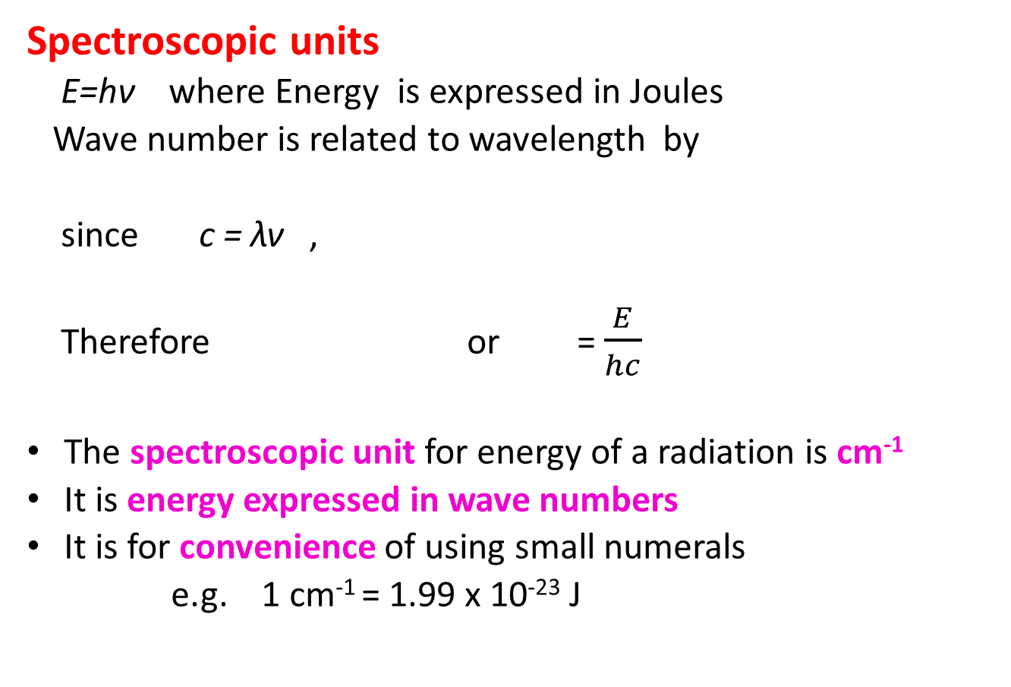
ENGINEERING CHEMISTRY
Module I- Molecular Spectroscopy
Spectroscopic units
E=hν where Energy is expressed in Joules
Wave number is related to wavelength by
since c = λν ,
Therefore or = $\frac{E}{hc}$
The spectroscopic unit for energy of a radiation is cm⁻¹
It is energy expressed in wave numbers
It is for convenience of using small numerals
e.g. 1 cm⁻¹ = 1.99 x 10⁻²³ J

Slide 12
THANK YOU
Asha A
Department of Science and Humanities

